Slide 1
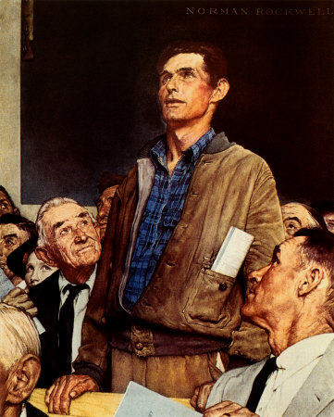
Freedom of Speech

Slide 2
Federalizing influence of Amendment 14.
Involves both freedom to give and hear speech.
Beliefs are most protected, actions can be most restricted…but speech falls somewhere in between.

Slide 3
Tests Used by Courts to Determine if Speech is Protected:
A. Bad tendency doctrine
State legislatures, not the courts should determine when speech should be limited
Speech can be limited when it might lead to harm.
B. Clear and present danger doctrine
Schenck v. U.S., 1919
Speech can be suppressed only if there is an imminent threat to society.
C. Preferred position doctrine
Speech should occupy a preferred position above other values. Government should never restrict it.

Slide 4
D. Vagueness
Speech restrictions cannot be written in too vague a manner. Must be clear to the average person (intelligence).
E. Least Drastic Means Test
Laws cannot restrict speech if there are other means to handle the problem.
F. Prior Restraint
Blocking speech before it is given.
Such action is presumed by courts to be unconstitutional.
Pentagon Papers case – court refused to impose prior restraint: revelations may have embarrassed government, but did not endanger national security.
G. Centrality of Political Speech
Political speech given special protection because of its importance to democracy. Less likely to be restricted.

Slide 5
H. “Fighting Words”
Not protected by Amendment 1. Speech that leads to violence can be restricted.
I. Symbolic Speech
Somewhere between speech and action. Generally protected.
U.S. v. O’Brien, 1968: draft card burning is not protected.
Tinker v. Des Moines, 1969: wearing armband on high school campus is protected.
Texas v. Johnson, 1989: flag burning is protected.
J. Sedition
In the past, could be a mere criticism of the government.
Smith Act, 1940: Advocacy of overthrowing the government could result in 20 years in prison
Supreme court narrowed definition further when it said that sedition was prohibited only when: There is imminent danger of an overthrow, and people are actually urged to do something rather than merely believe something.

